Slide 1
Evolution Of Computers - From 1st Generation to Modern AI
A journey from Vacuum Tubes to Artificial Intelligence
Roll Number: 25K-3021

Slide 2
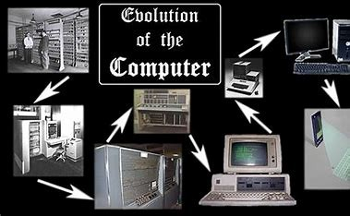
INTRODUCTION
Computer have evolved dramatically over the decades.
From bulky vacuum tubes machines of the 1940s to today’s AI-driven systems.
Each generation made computers faster, smaller, and more powerful.
This presentation explores how computers evolved into modern AI.

Slide 3
Timeline of Computer Generations
1st Generation
1940s – 1950s
Vacuum Tubes
2nd Generation
1950s – 1960s
Transistors
3rd Generation
4th Generation
1960s – 1970s
Integrated Circuits
1970s – Present
Microprocessors
5th Generation
Present – Future
Artificial Intelligence
Vacuum Tubes
Transistors
Integrated Circuits
Microprocessor
Artificial Intelligence

Slide 4
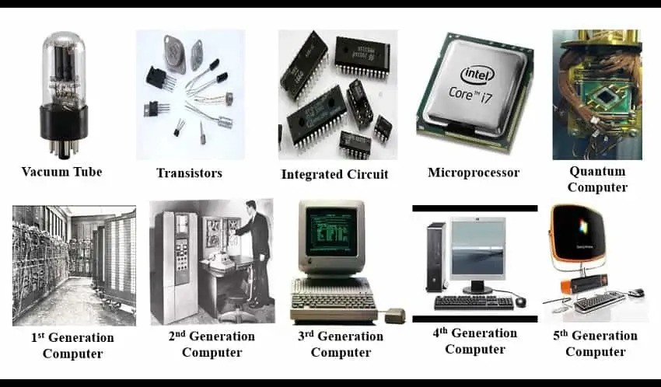
Comparison of Generations
Generation | Speed | Size | Technology
1st | Slow (ms) | Very Large | Vacuum Tubes
2nd | Microseconds | Smaller | Transistors
3rd | Nanoseconds | Smaller | Integrated Circuits
4th | Picoseconds | Tiny | Microprocessors
5th | AI-driven | Compact | Artificial Intelligence

Slide 5
Growth of Computing Power Over Time

Slide 6

Modern AI Systems
Represents the 5th Generation of computers.
Key Features:
Machine Learning & Deep Learning
Natural Language Processing
Robotics & Automation
Decision-making & Problem-solving
AI is now applied in healthcare, education, business, and daily life.

Slide 7
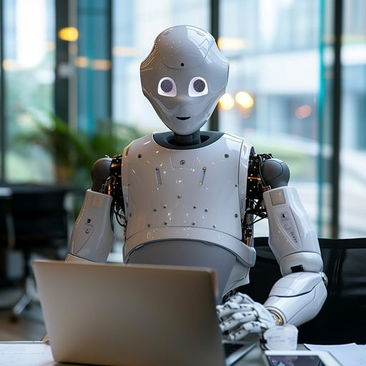
Conclusion
The evolution of computers is a remarkable journey.
From vacuum tubes → microprocessors → AI systems.
Computers reshaped society and technology.
The future promises even more advanced AI that will revolutionize the world.

